Slide 1
Efficient Simulation of Light Transport in Scenes with Participating Media using Photon Maps
Paper by Henrik Wann Jensen, Per H. Christensen
Presented by Abhinav Golas

Slide 2
Overview
What is participative media?
Mathematical formulation
The Photon Map approach
Results & Discussion

Slide 3
Overview
What is participative media?
Mathematical formulation
The Photon Map approach
Results & Discussion

Slide 4
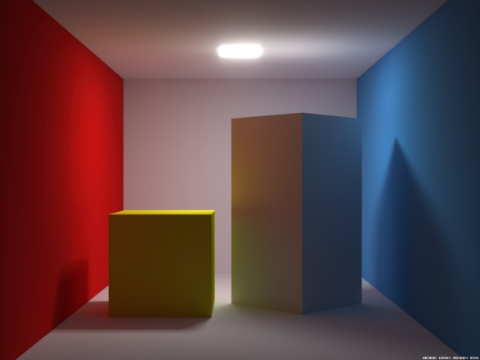
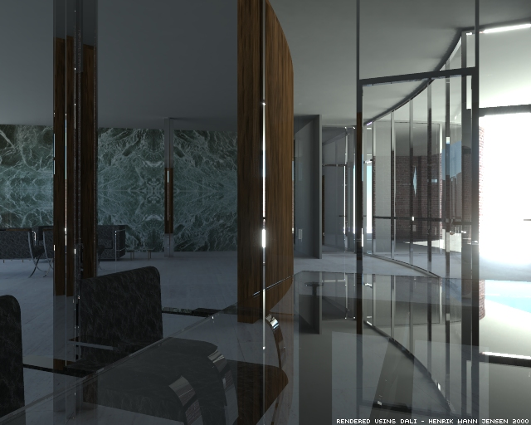
What is participative media?
Till now
Assumption – only objects affect light
The medium does not affect light
What about?
Fog
Smoke
Fire

Slide 5
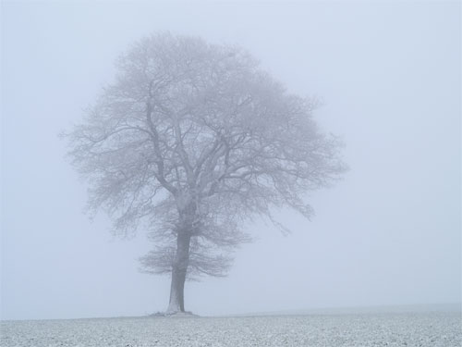
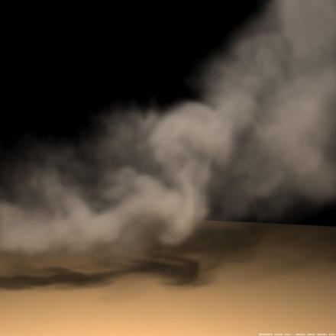
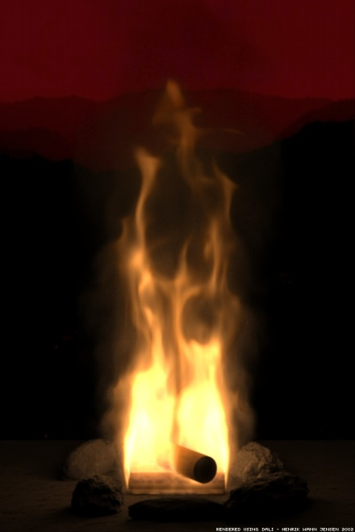
What is participative media? (2)
Light does interact with the certain media
Absorption
Scattering
Emission

Slide 6
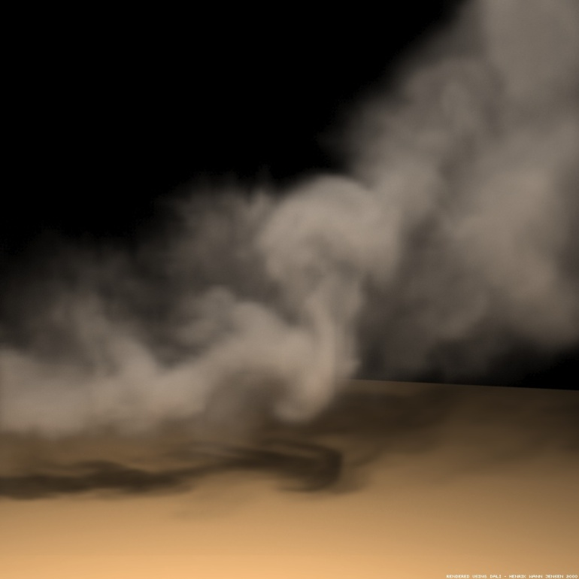
Absorption
Light can be attenuated while passing through certain media
Smoke

Slide 7
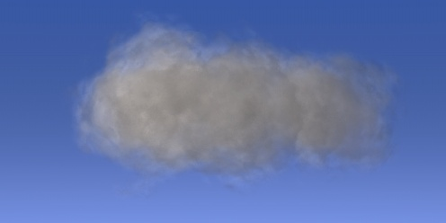
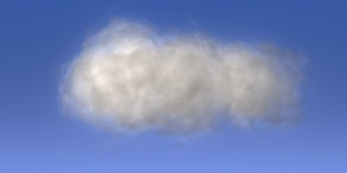
Scattering
Light can scatter when passing through certain media
Single scattering – light is scattered once before reaching eye
Multiple scattering – light is scattered more than once before reaching eye

Slide 8
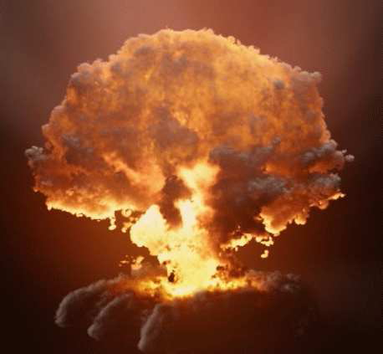
Emission
In some cases the media will emit light
Fire
Explosions

Slide 9
Overview
What is participative media?
Mathematical formulation
The Photon Map approach
Results & Discussion

Slide 10
Mathematical formulation
Emitted radiance
In-scattered radiance
Absorption
Out-scattered radiance
α(x) – Absorption coefficient
σ(x) – Scattering coefficient
L_{e} – Emitted light
L_{i} – In-scattered radiance

Slide 11
Mathematical Formulation (2)
κ(x) – Extinction coefficient = α(x) + σ(x)
f(x,ω’, ω) – Scattering function

Slide 12
Mathematical Formulation (3)
Simply integrating along a path from x₀ to x
τ(x’,x) – Transmittance along line segment along x’ to x, =

Slide 13
Mathematical formulation (4)
And we’re done with the math!

Slide 14
Overview
What is participative media?
Mathematical formulation
The Photon Map approach
Results & Discussion

Slide 15
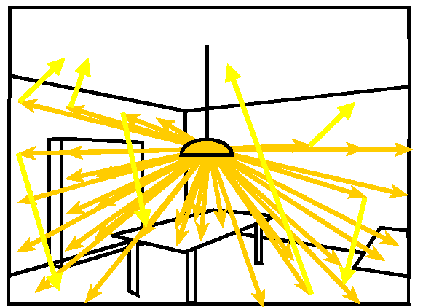
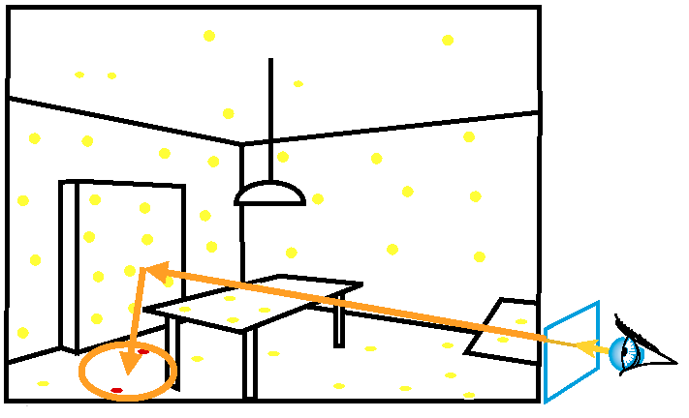
Photon Map review
2 pass algorithm
Pass 1: Trace photons through the scene
Pass 2: Use photons in ray tracing to get indirect illumination estimate
Store in 2 k-D trees
Caustic Map (LS⁺D)
Global/Indirect Illumination Map (L(S|D)⁺D)

Slide 16
The Photon Map approach
Extend previous surface photon map approach
Changes
Define a “volume photon map”
Photon data structure needs to be augmented with direction
Justification for using k-D tree for storing photons! – 3-D storage data structure required
Only indirect illumination – only store photons which
Have reflected or transmitted off an object before interaction with media (L(S|D)⁺M)
Have been scattered at least once by media (LM⁺)

Slide 17
Ray Marching
Integration scheme
Move through a region with some step Δx
Integrate function with sampling at x_{k}
Used extensively for volume integration
X0
X1
X2
Xk

Slide 18
Photon Map algorithm for participating media (Pass 1)
At step x_{k}
Interacts with media
Scatters
Absorbed
Does not interact
Move Δx to x_{k+1}
Store into photon map
From light source?
Russian roulette with σ(x)/κ(x)
No
Yes

Slide 19
Rendering pass (Pass 2)
Ray march through volume
At each step
Δx_{k} is the step – can be recursively halved if radiance changes by too much
Step size is also jittered to avoid aliasing

Slide 20
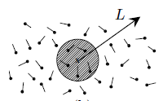
Finding In-scattered radiance
Gather n nearest photons and use their flux ΔΦ to collect radiance
In this step we only use indirect illumination, hence only those photons having indirect illumination are used

Slide 21
Overview
What is participative media?
Mathematical formulation
The Photon Map approach
Results & Discussion

Slide 22
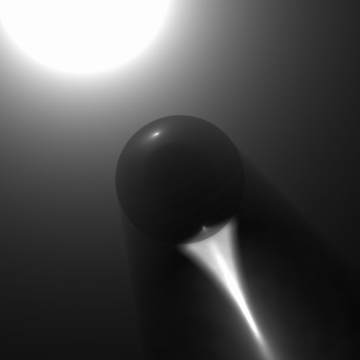
Results
Volume caustics!

Slide 23
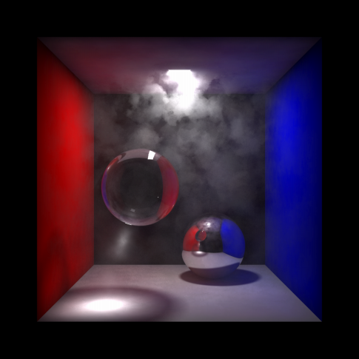
Results (2)
Scattering and absorption in an anisotropic heterogeneous media

Slide 24
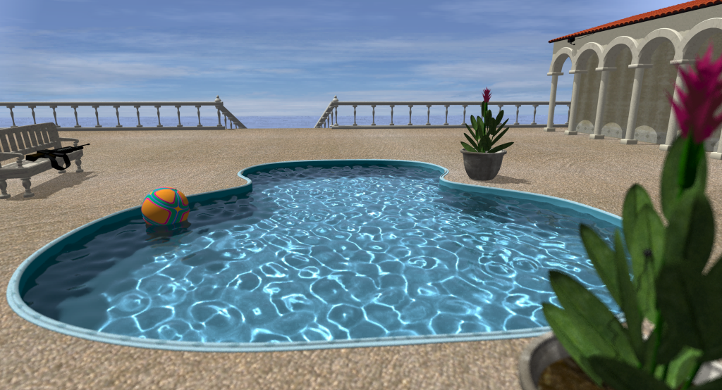
Results (3)
Volume caustics for water

Slide 25
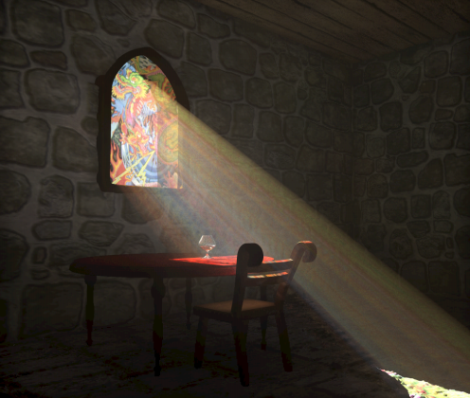
Results (4)

Slide 26
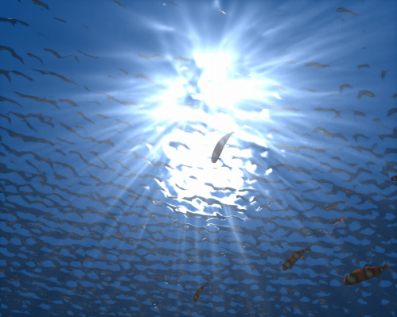
Results (5)
God (or crepuscular) rays

Slide 27
Advantages/Pitfalls
Advantages
Claimed to be faster than Monte-Carlo methods
Better image quality
Pitfalls
Large number of photons may be required – memory requirement
Doesn’t scale to large scenes too well – people usually put it in future work
Still need light sources to model emissive media – no heuristic for naturally emitting media

Slide 28
References
Efficient Simulation of Light Transport in Scenes with Participating Media using Photon Maps – Henrik Wann Jensen, Per H. Christensen
Smoke simulation for Large Scale Media – Fedkiw et al.
Per H. Christensen - http://www.seanet.com/~myandper/per.htm
Henrik Wann Jensen - http://graphics.ucsd.edu/~henrik/
Certain images from presentation by Jen-Yuan Chiang on the same paper (http://www.csie.ntu.edu.tw/~cyy/courses/rendering/05fall/assignments/pres/slides/volume.ppt)

